Slide 1

The Machine Learning Process
Python 101 – Collections Module
Sathish Ravichandran

Slide 2

Collections Module
The collections module is a built-in module that implements specialized container data types providing alternatives to Python’s general-purpose built-in containers. We've already gone over the basics: dict, list, set, and tuple..

Slide 3
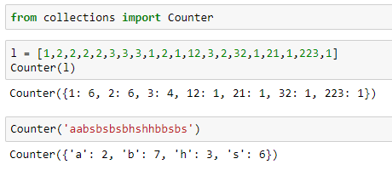
Counter
Counter is a dict subclass which helps count hash-able objects. Inside of it elements are stored as dictionary keys and the counts of the objects are stored as the value.
Notes:
from collections import Counter
l = [1,2,2,2,2,3,3,3,1,2,1,12,3,2,32,1,21,1,223,1]
Counter(l)
Counter('aabsbsbsbhshhbbsbs')

Slide 4
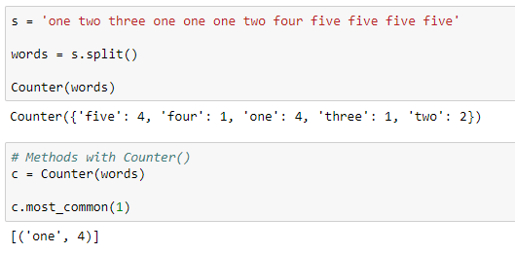
Counter
Counter with word in a sentence
Notes:
s = 'one two three one one one two four five five five five'
words = s.split()
Counter(words)
# Methods with Counter()
c = Counter(words)
c.most_common(1)

Slide 5
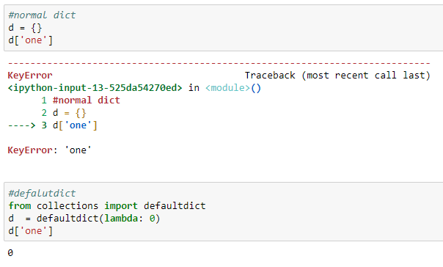
Defaultdict
A defaultdict will never raise a KeyError. Any key that does not exist gets the value returned by the default factory
Notes:
#normal dict
d = {}
d['one’]
#defalutdict
from collections import defaultdict
d = defaultdict(lambda: 0)
d['one']

Slide 6
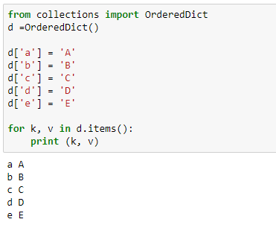
An Ordered Dictionary
An OrderedDict is a dictionary subclass that remembers the order in which its contents are added.

Slide 7
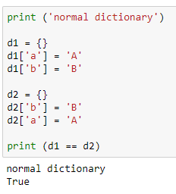
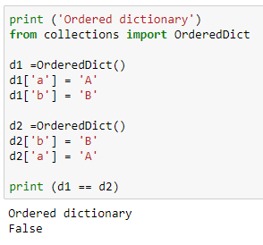
An Ordered Dictionary
Equality with an Ordered Dictionary
A regular dict looks at its contents when testing for equality. An OrderedDict also considers the order the items were added.
Notes:
print ('normal dictionary')
d1 = {}
d1['a'] = 'A'
d1['b'] = 'B'
d2 = {}
d2['b'] = 'B'
d2['a'] = 'A'
print (d1 == d2)
print ('Ordered dictionary’)
from collections import OrderedDict
d1 =OrderedDict()
d1['a'] = 'A'
d1['b'] = 'B'
d2 =OrderedDict()
d2['b'] = 'B'
d2['a'] = 'A'
print (d1 == d2)

Slide 8
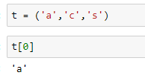
Namedtuple
The standard tuple uses numerical indexes to access its members
For simple use cases, this is usually enough. On the other hand, remembering which index should be used for each value can lead to errors, especially if the tuple has a lot of fields and is constructed far from where it is used. A namedtuple assigns names, as well as the numerical index, to each member.
Notes:
t = ('a','c','s’)
t[0]

Slide 9
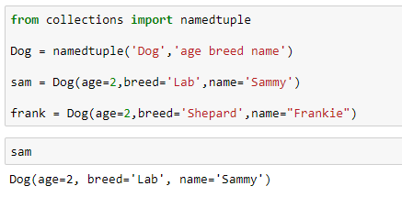
Namedtuple
Each kind of namedtuple is represented by its own class, created by using the namedtuple() factory function. The arguments are the name of the new class and a string containing the names of the elements.
Notes:
from collections import namedtuple
Dog = namedtuple('Dog','age breed name')
sam = Dog(age=2,breed='Lab',name='Sammy')
frank = Dog(age=2,breed='Shepard',name="Frankie")

Slide 10
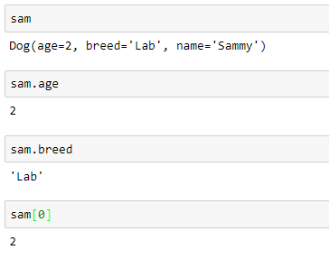
Namedtuple
Notes:
from collections import namedtuple
Dog = namedtuple('Dog','age breed name')
sam = Dog(age=2,breed='Lab',name='Sammy')
frank = Dog(age=2,breed='Shepard',name="Frankie")
Sam
sam.age
sam.breed
sam[0]

Slide 11
Thank you
The Capacity to learn is a gift;
The ability to learn is a skill;
The willingness to learn is a choice.
-Brian Herbert

